Slide 1
FUNNY MOMENTS OF John Paul II
Mateusz Krysztofiak kl. VI A

Slide 2
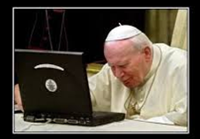
He was open to new technologies

Slide 3
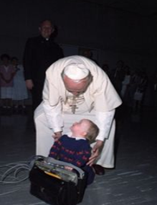
John Paul II loved kids and always had funny moments with them.

Slide 4
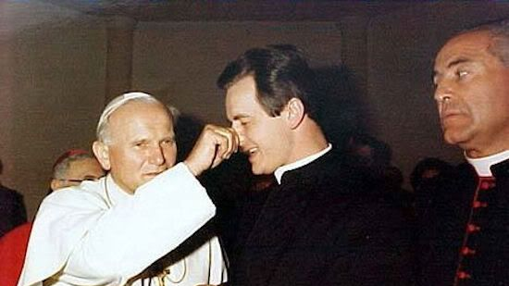
John Paul II enjoyed making jokes like in this picture

Slide 5
John Paul II always had a great distance to himself
In my opinion this Pope should be - always - called John Paul the Great !

Slide 6
Barka In one of my favourite Netflix films this song was sung …... in the main part.... third season.
John Paul II loved singing and his favourite song was ,, Barka"
1. Lord, you have come to the lakeshore looking neither for wealthy nor wise ones. You only asked me to follow humbly. Refrain O Lord, with your eyes you have searched me, kindly smiling, have spoken my name. Now my boat's left on the shoreline behind me; by your side I will seek other seas. 2. You know so well my possessions; my boat carries no gold and no weapons; But nets and fishes my daily labor. 3. You need my hands, full of caring, through my labors to give others rest, and constant love that keeps on loving. 4. You, who have fished other oceans ever longed-for by souls who are waiting, my loving friend, as thus you call me.

