Slide 1
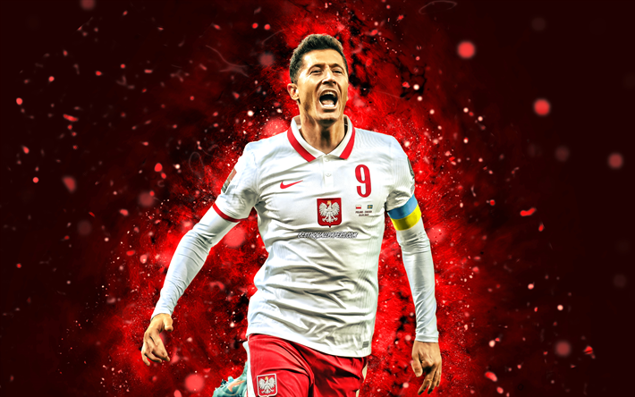
Everybody knows that
Iga Świątek
and
Robert Lewandowski
are from...
The question is
- what do you know
about
?
Not much?
We’ll help you then.

Slide 2
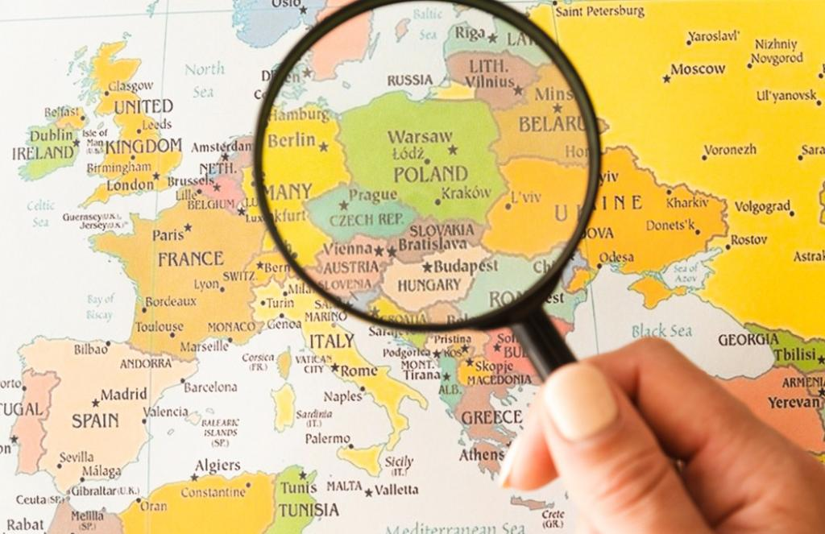

Slide 3
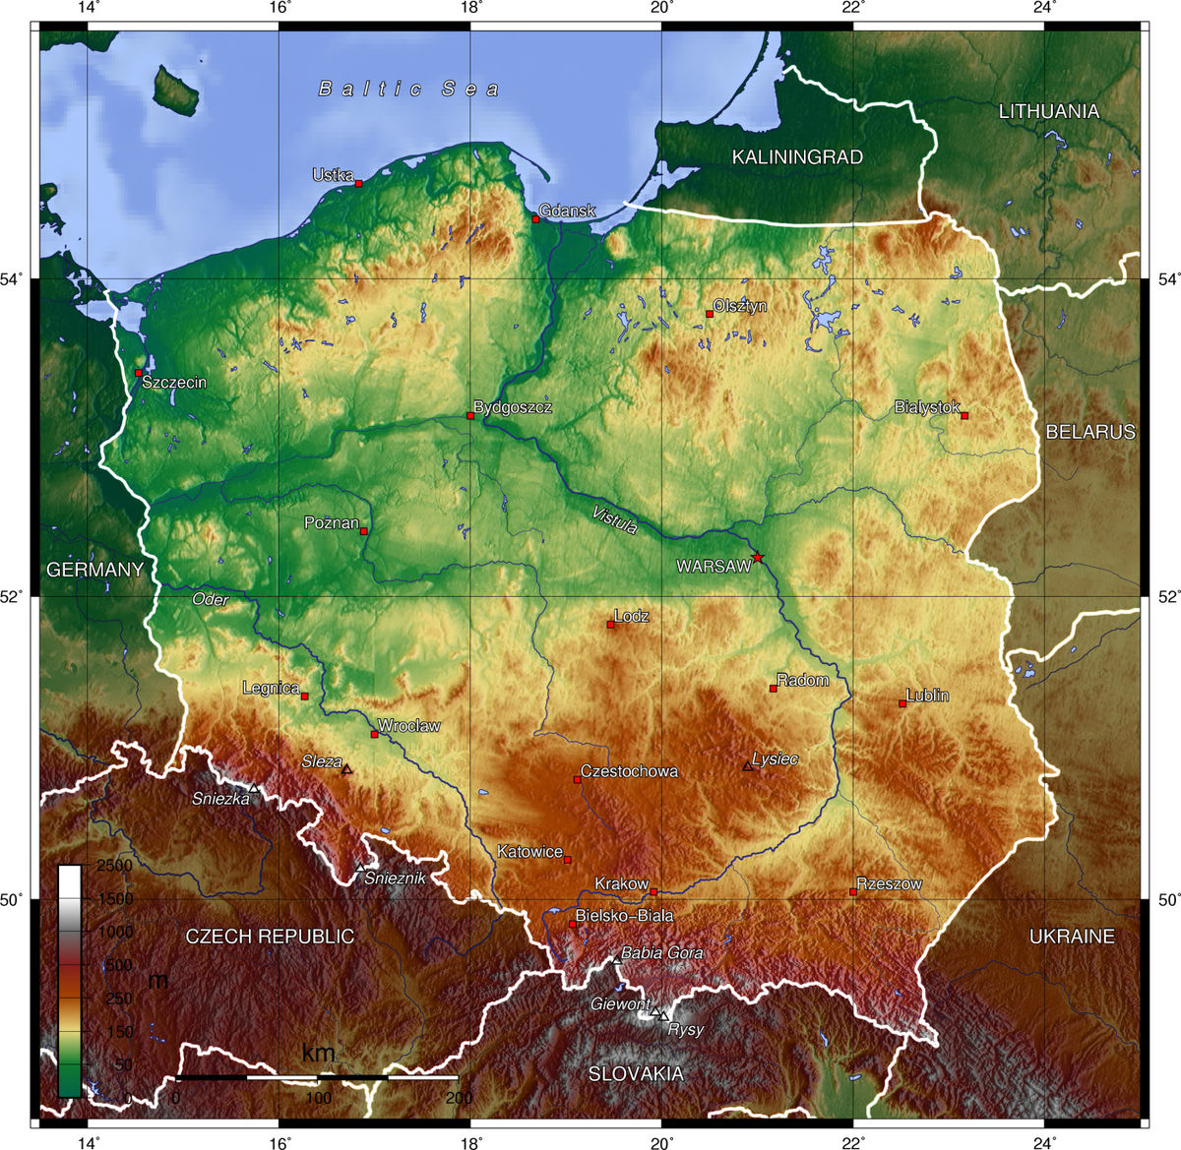
As you can see, we’re really lucky – we’ve got high and low mountains, numerous lake districts, vast plains and the sea with sandy beaches.
In other words, Poland is a paradise for skiers, swimmers, hikers, holidaymakers…

Slide 4
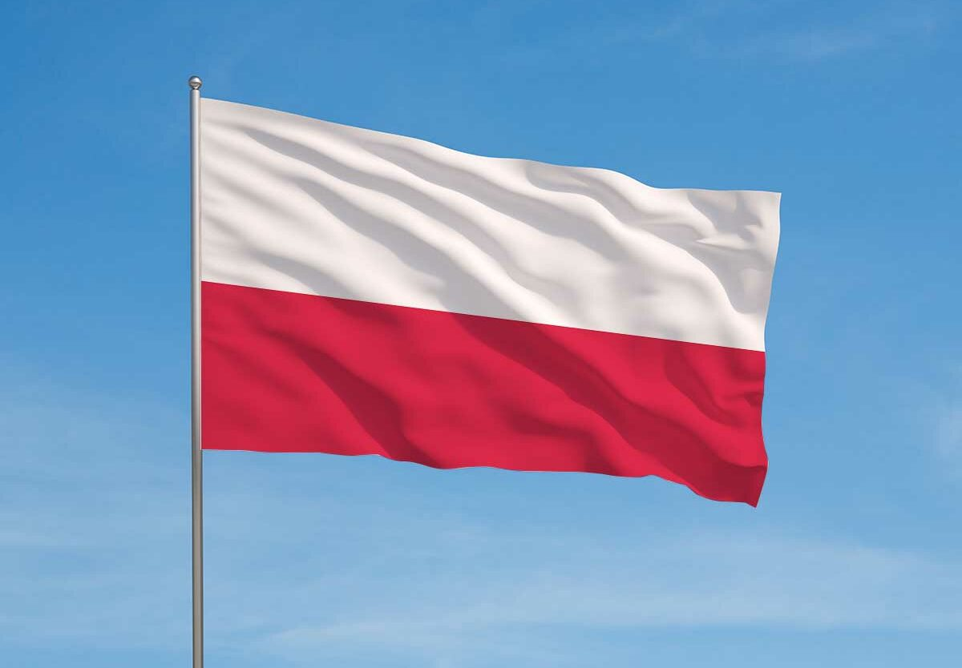
Polish flag

Slide 5
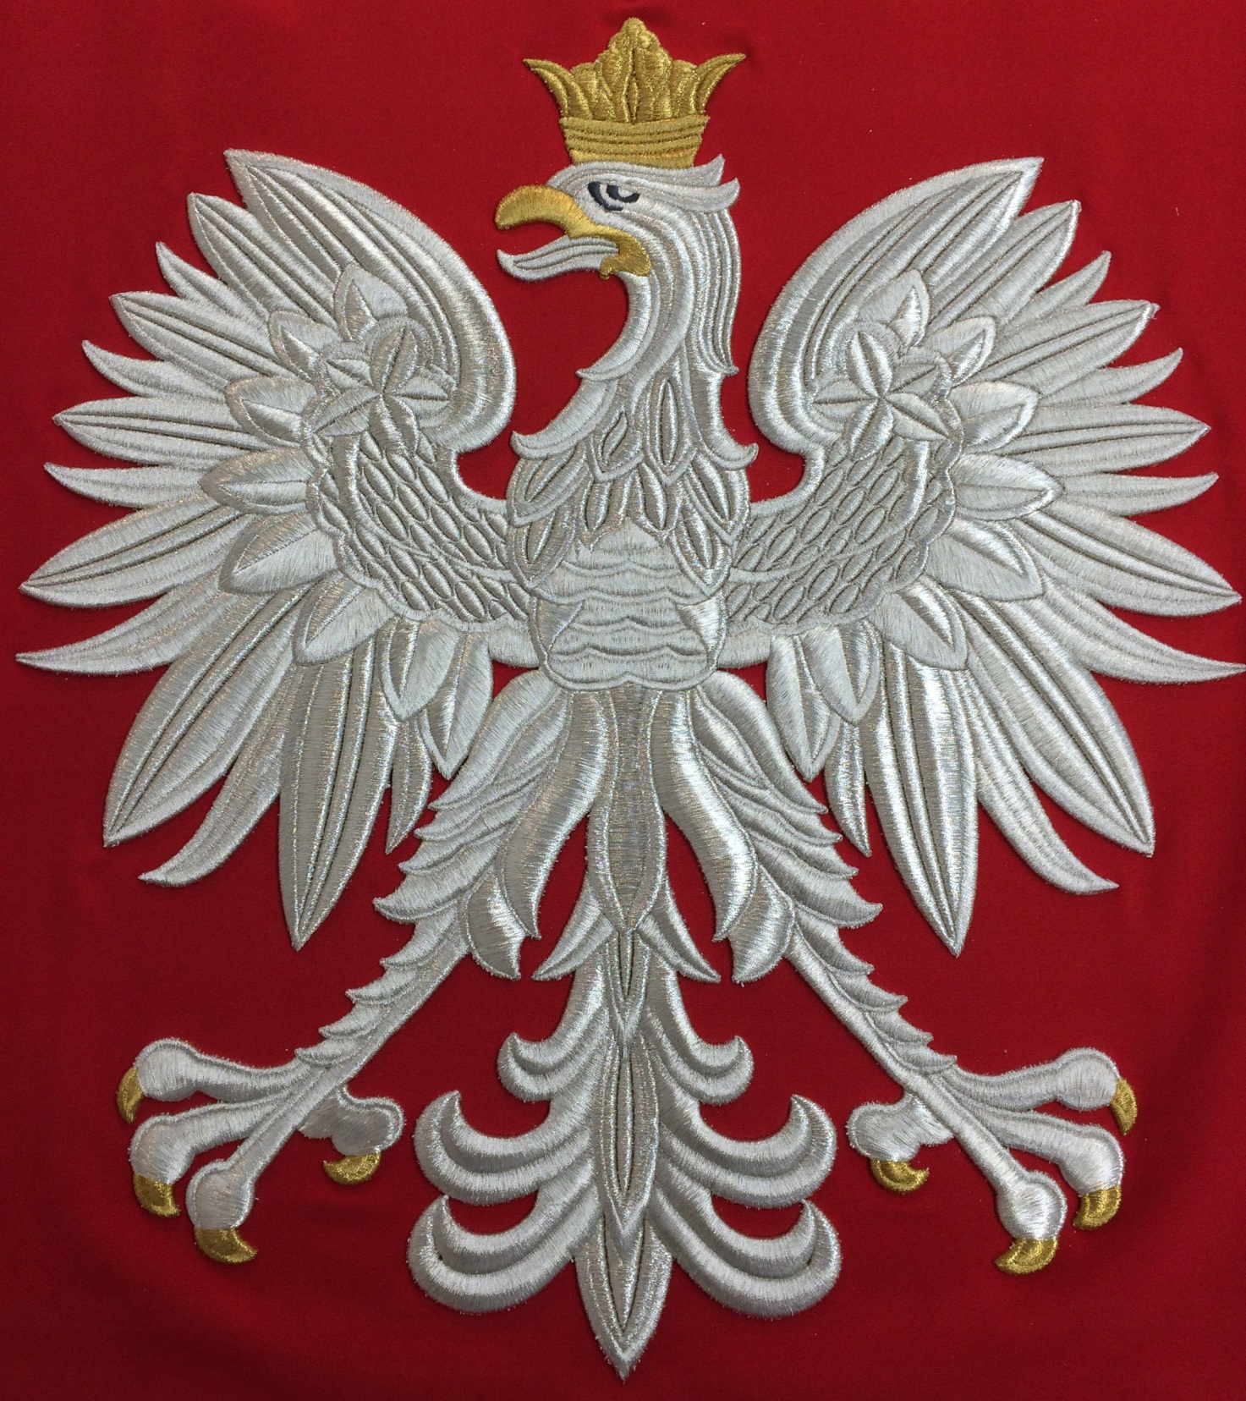
WHITE
EAGLE
THE NATIONAL EMBLEM

Slide 6
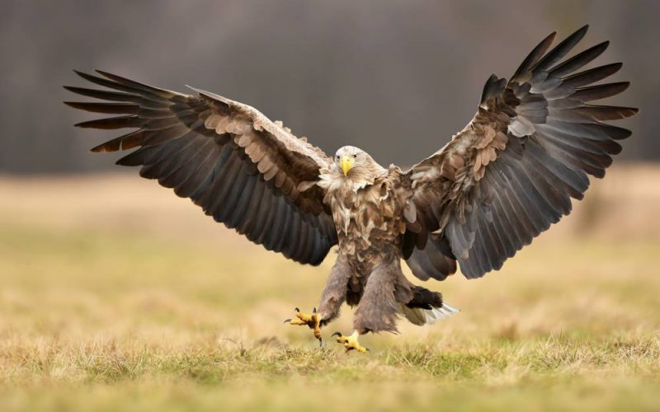
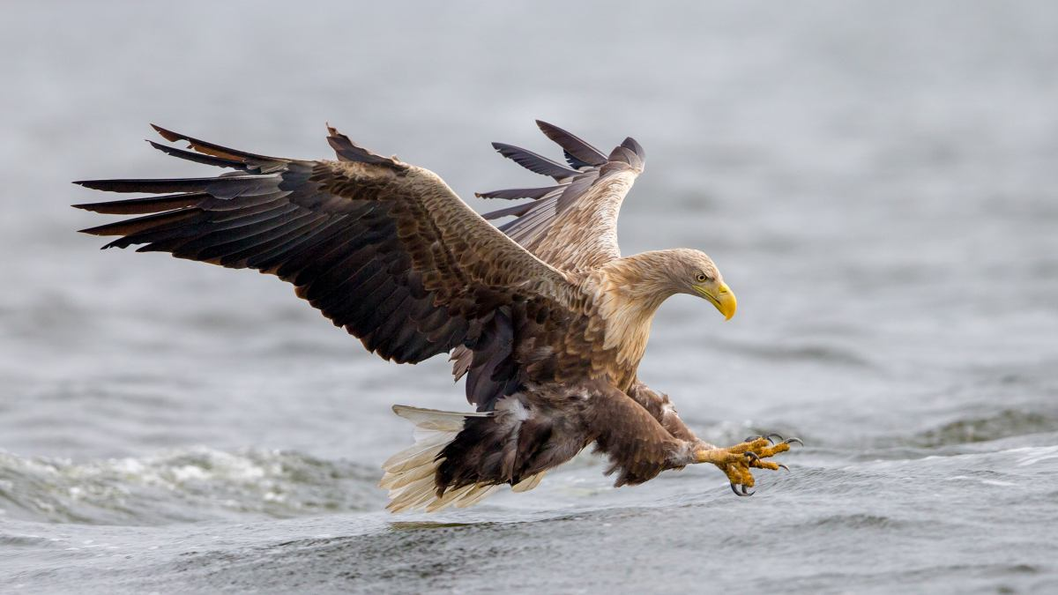
WHITE EAGLES
Unfortunately,
these powerful
BIRDS
OF PREY
are in danger
of extinction
now.

Slide 7
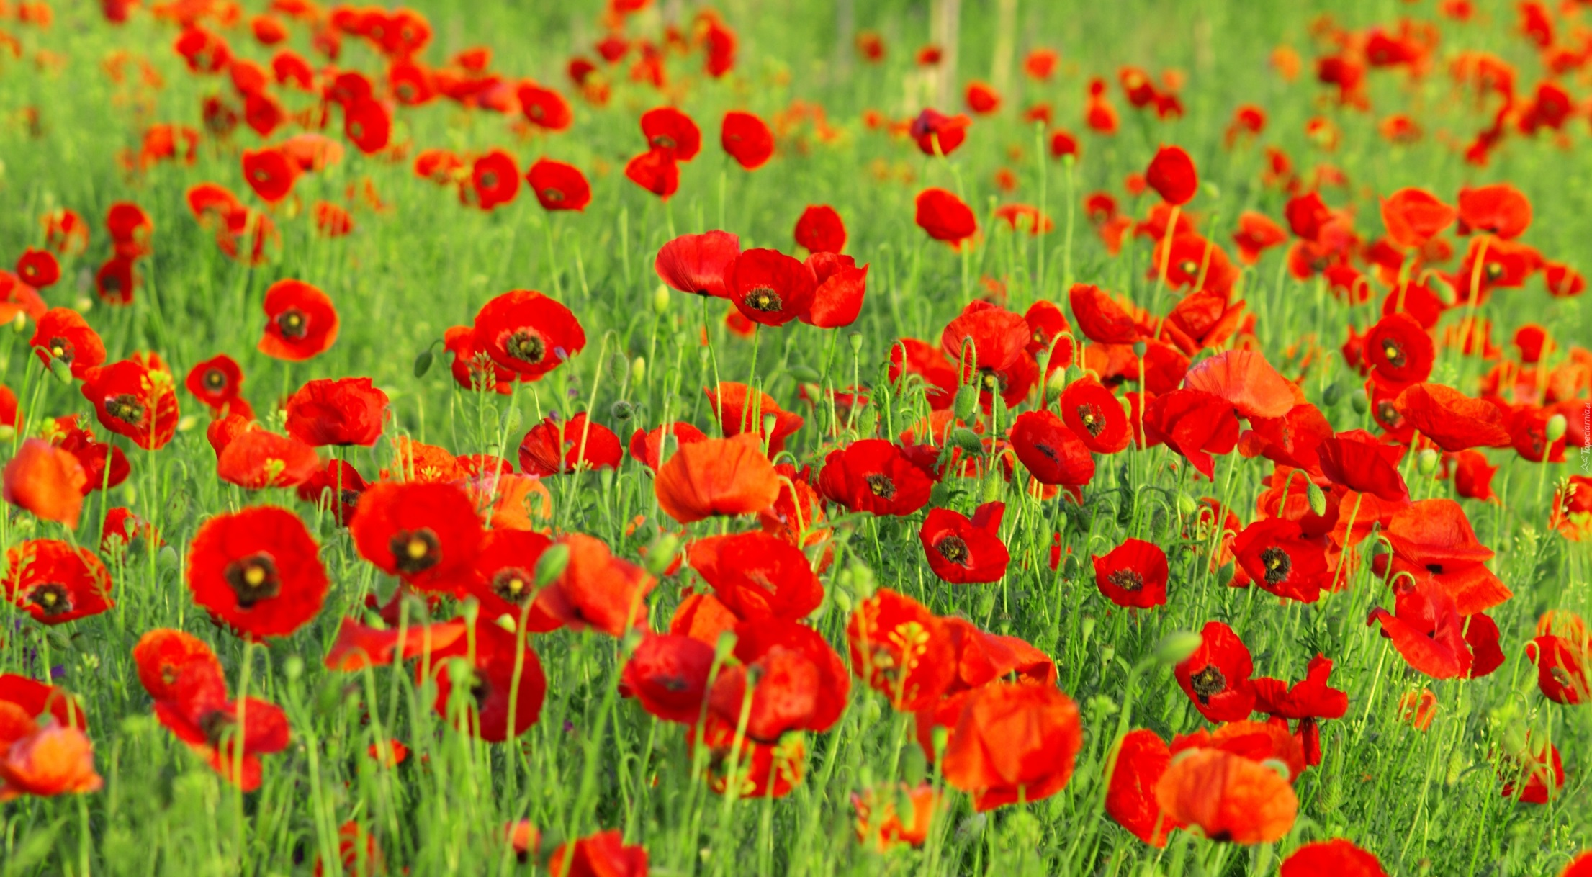
RED POPPY
- OUR PLANT SYMBOL
as red as blood shed on battlefields

Slide 8
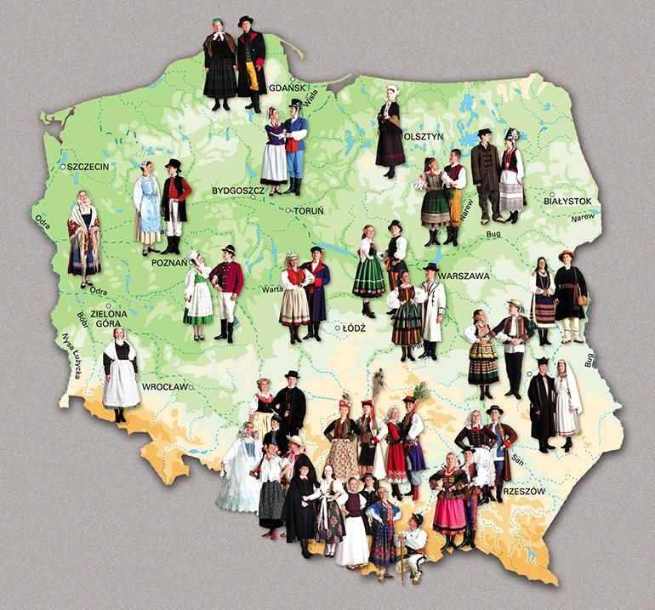
POLISH
FOLK
FASHION

Slide 9
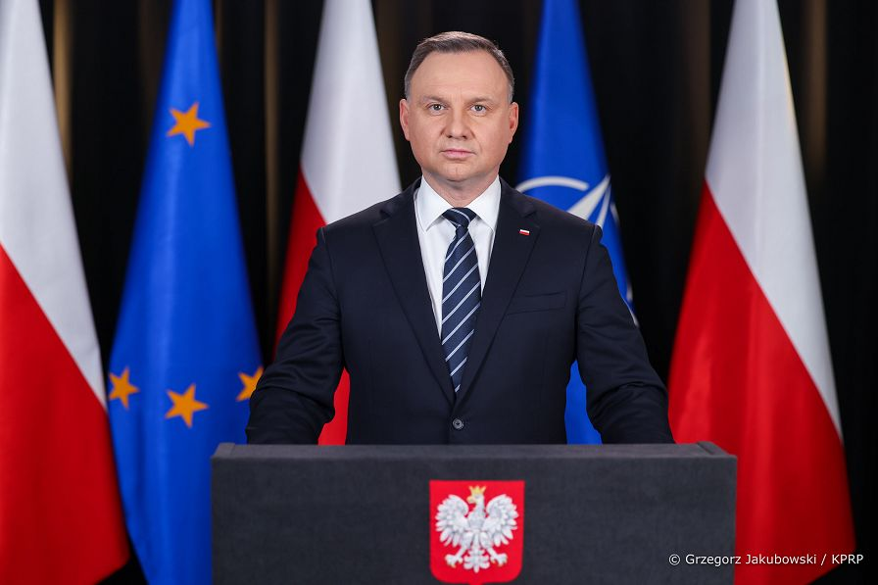
Andrzej Duda, the President of Poland

Slide 10
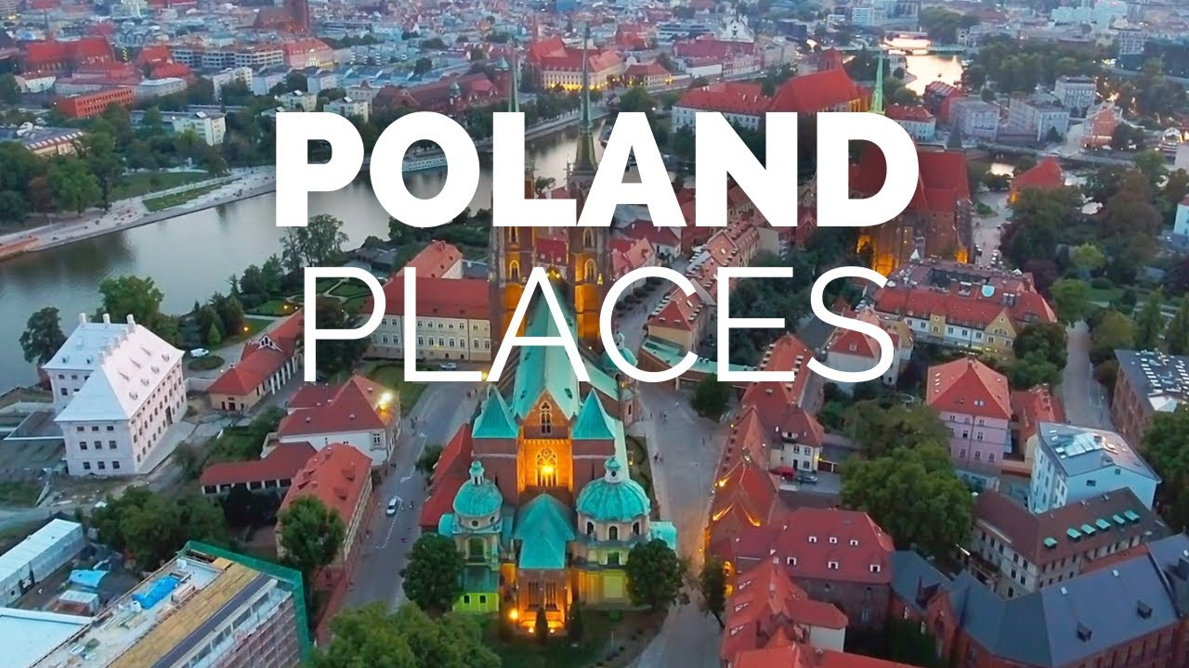

Slide 11
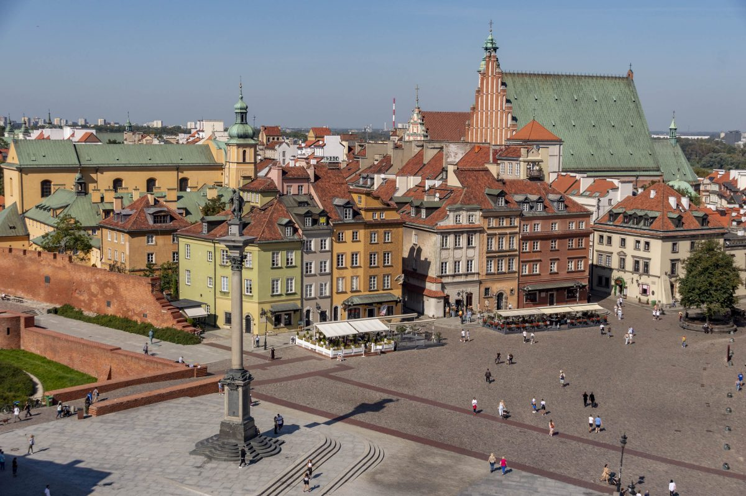
Warsaw – the capital
The city, completely ruined by the Nazis, rose like a phoenix from the ashes.

Slide 12
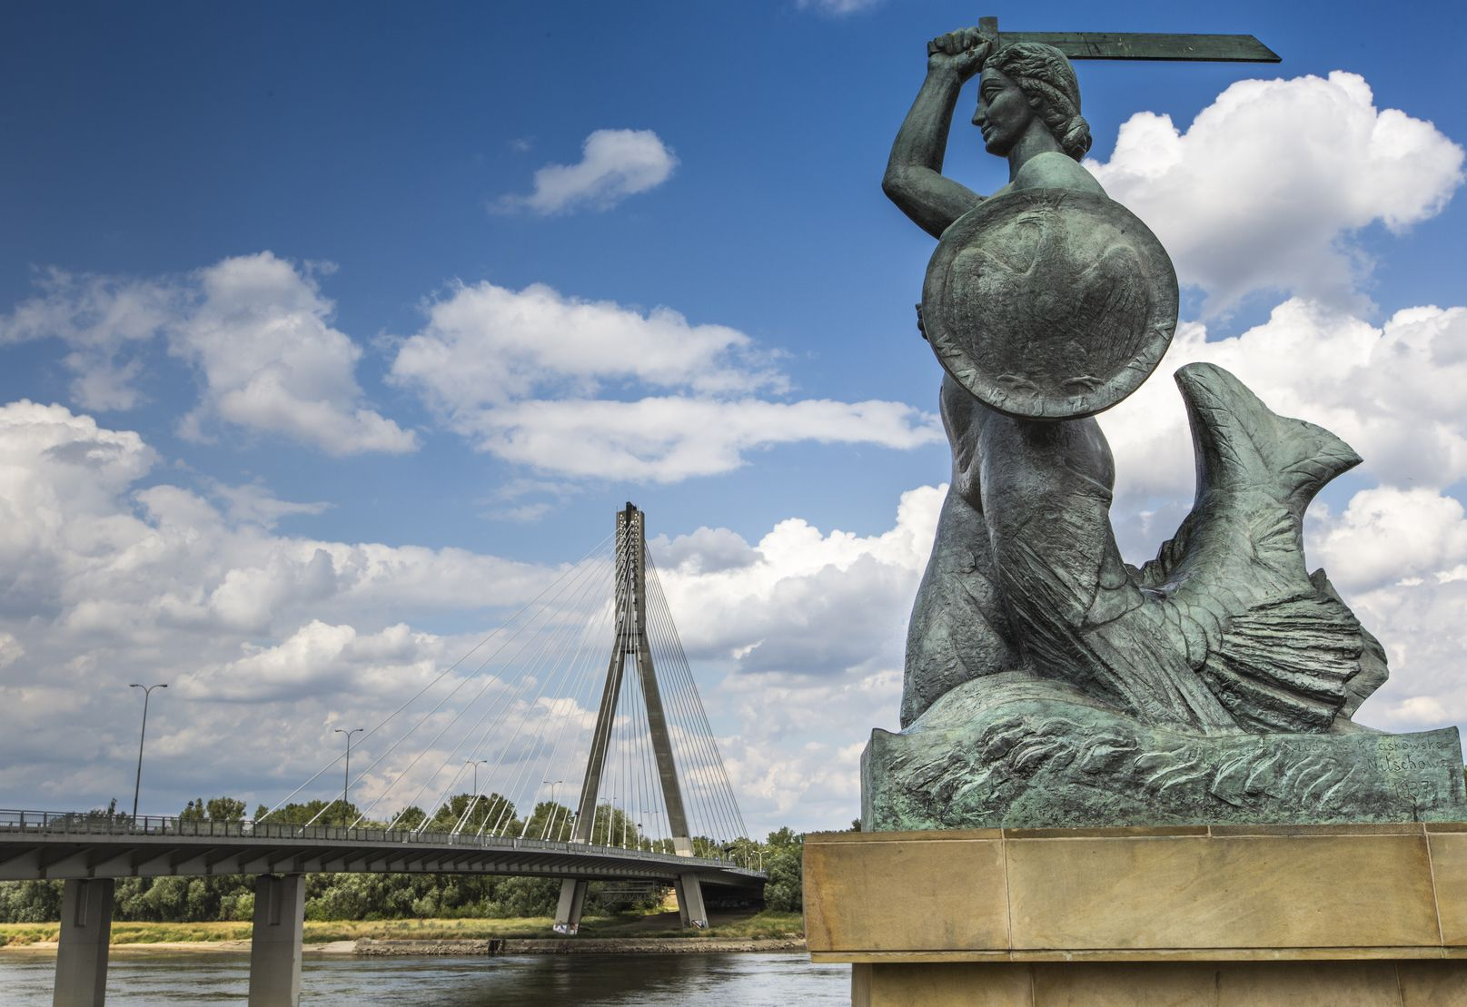
Warsaw’s mermaid
by the Vistula River

Slide 13
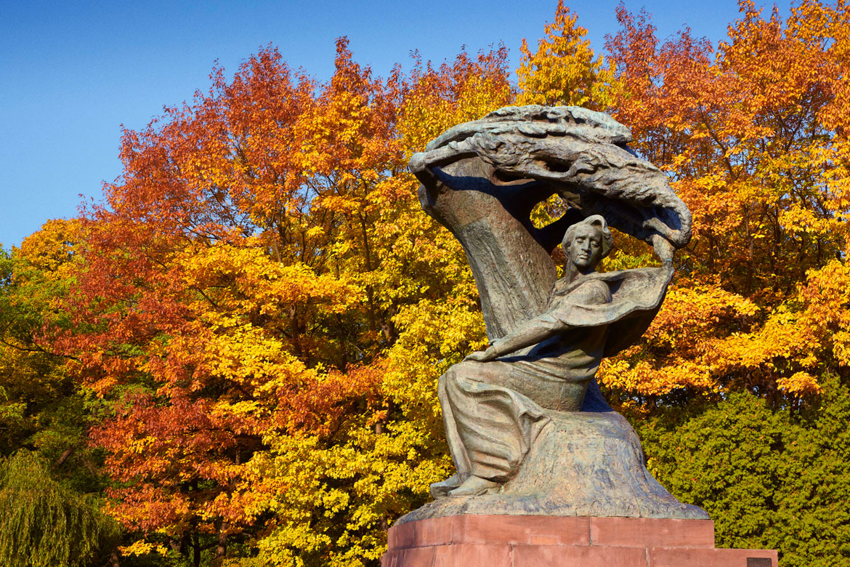
The Frédéric Chopin Monument in Warsaw's Royal Baths ...

Slide 14
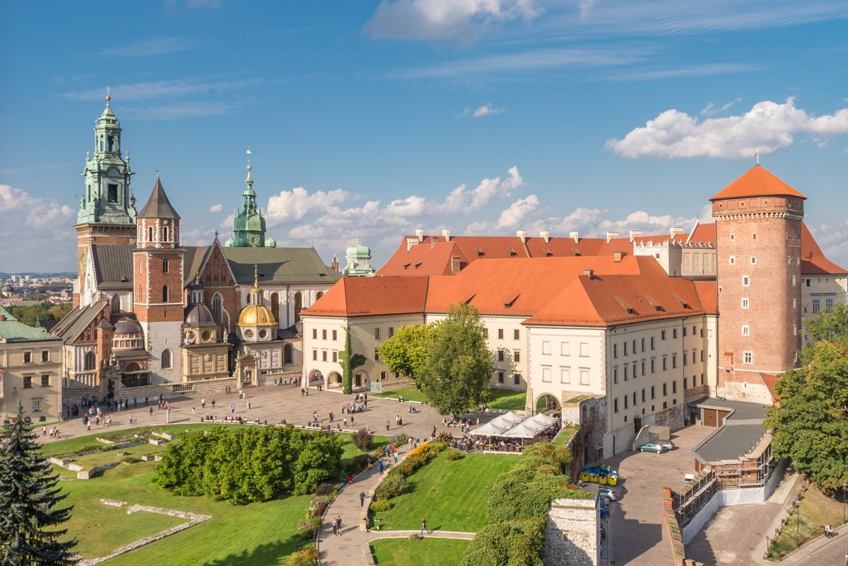
Krakow – the previous capital of Poland
The Wawel Royal Castle and the Wawel Hill constitute the most historically
and culturally important site in Poland.

Slide 15
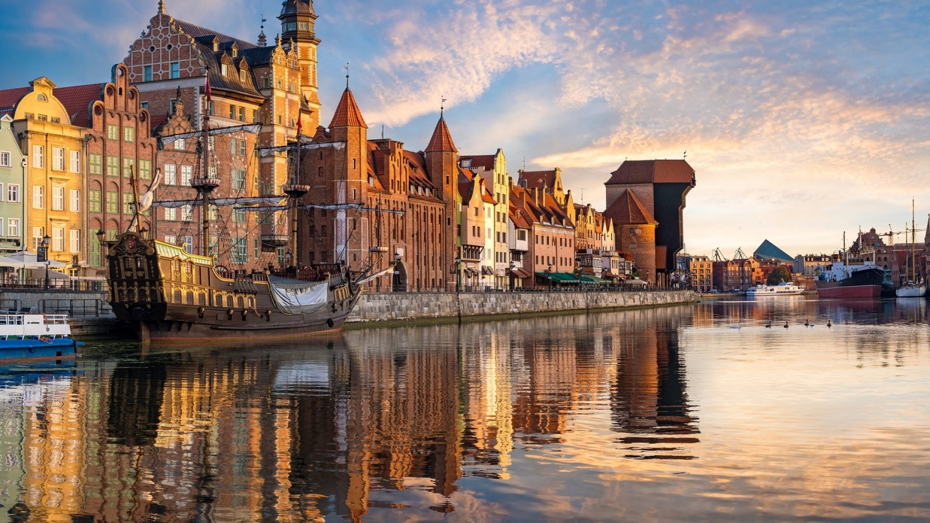
Picturesque Gdańsk, a port city by the Gdańsk Bay
It is famous for its derrick, historic shipyard and colourful townhouses.

Slide 16
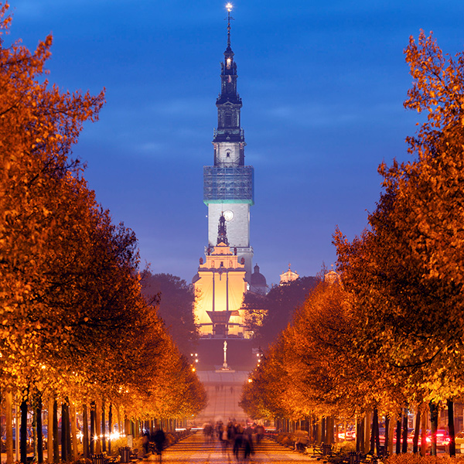
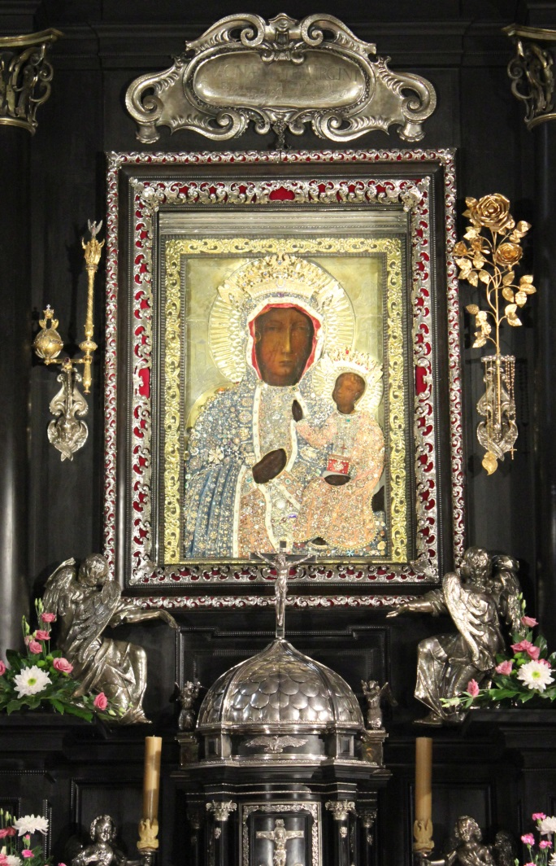
Częstochowa
The Jasna Góra Monastery in Częstochowa is a shrine dedicated
to the Virgin Mary and one of the country's places of pilgrimage.

Slide 17
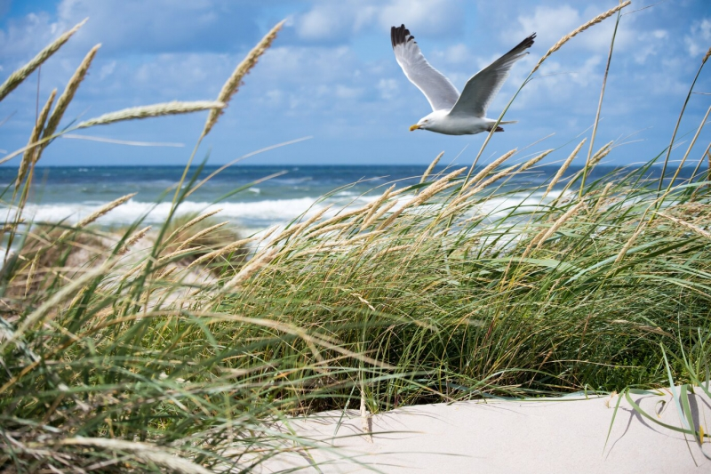
The Polish coastline was estimated at 770 km in length.

Slide 18
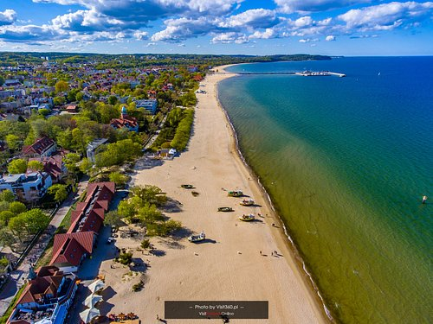
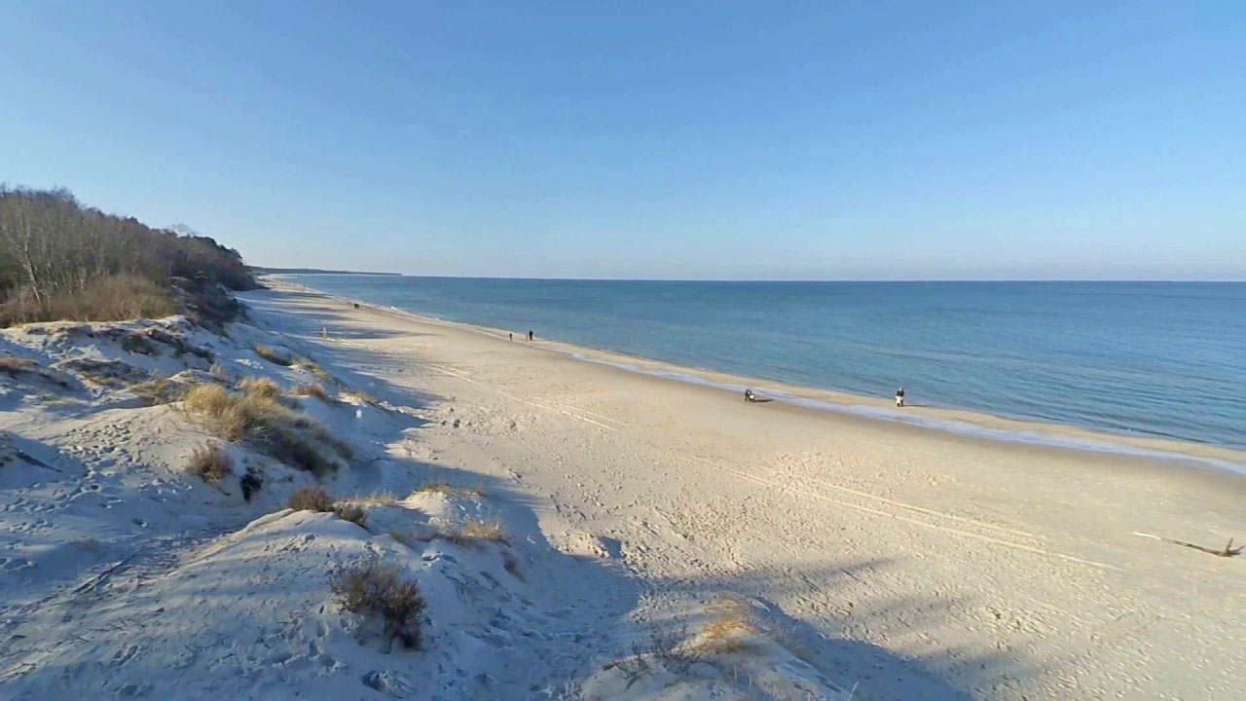
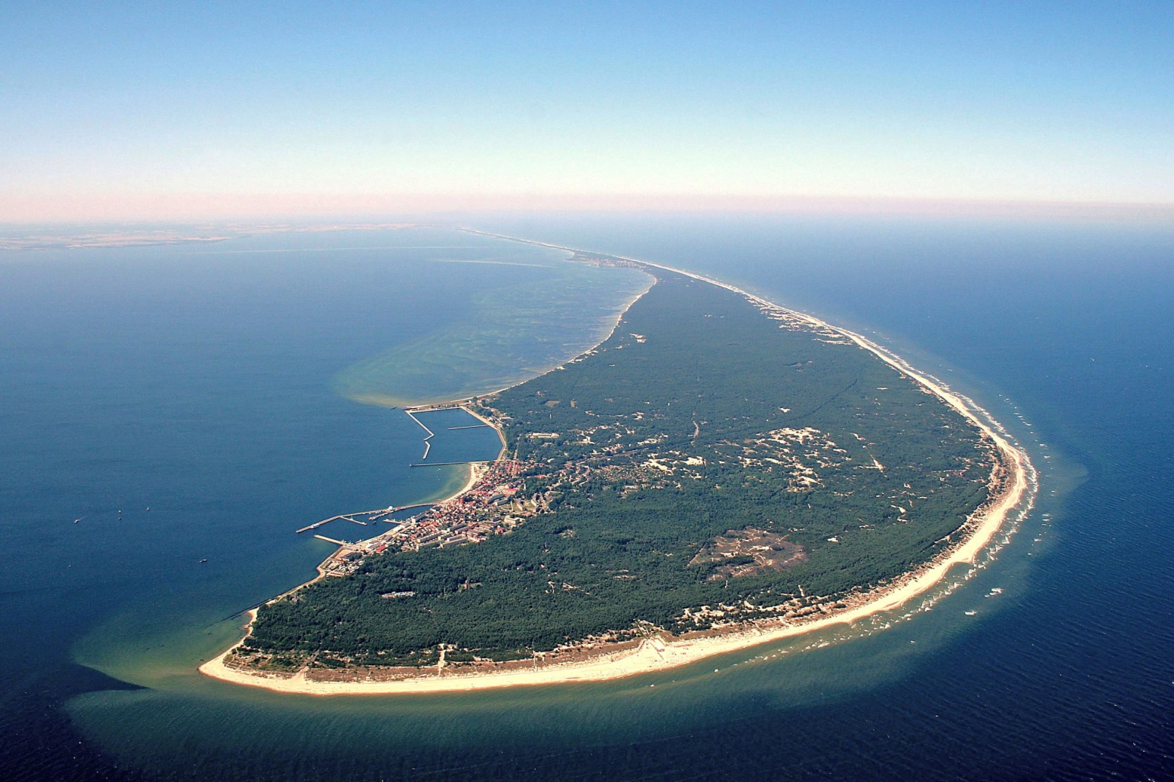
The Baltic Sea
invites
to numerous
sandy
beaches.

Slide 19
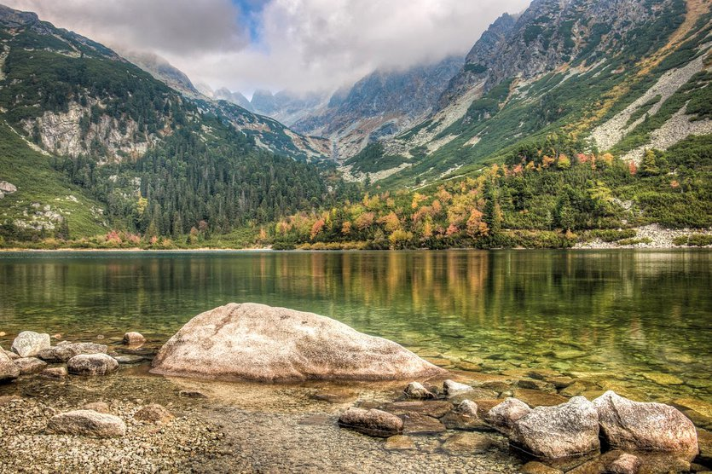
Morskie Oko (The Eye of the Sea),
is the largest lake in the Tatra Mountains
There are several mountain ranges in Poland,
all located in the southern part of the country.

Slide 20
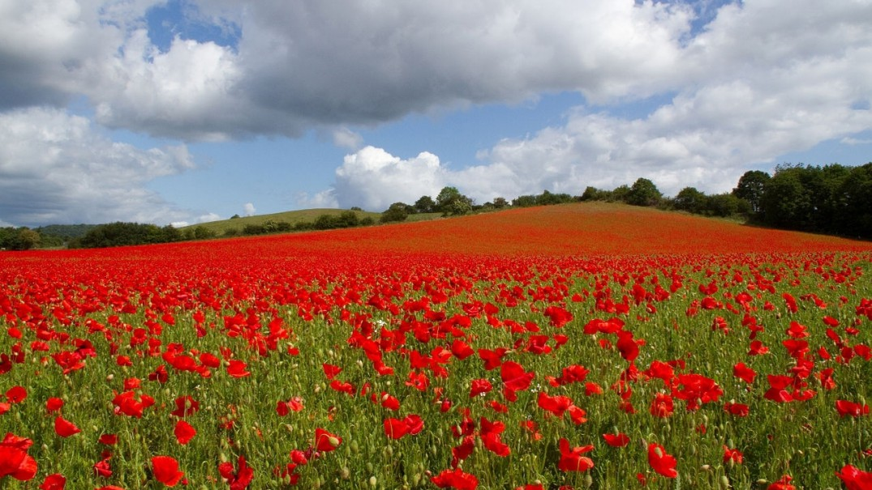
Polish uplands

Slide 21
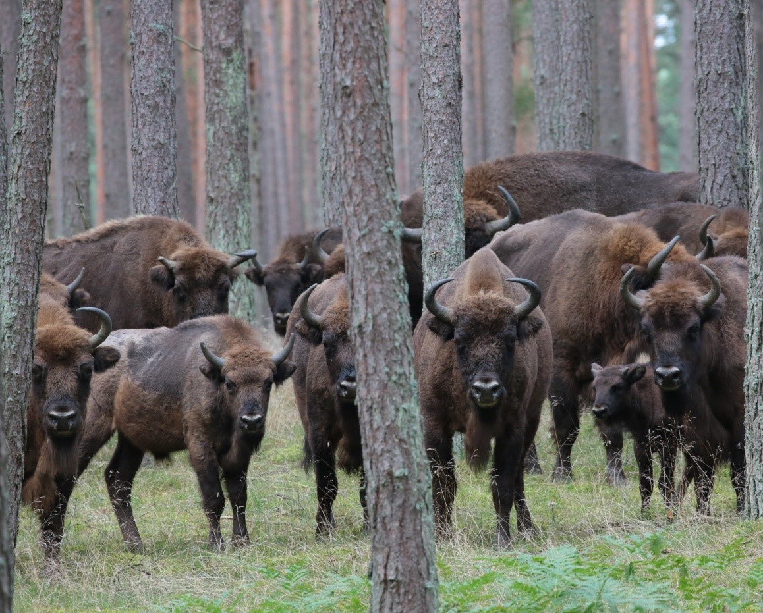
European bisons in Poland’s Białowieża forest

Slide 22
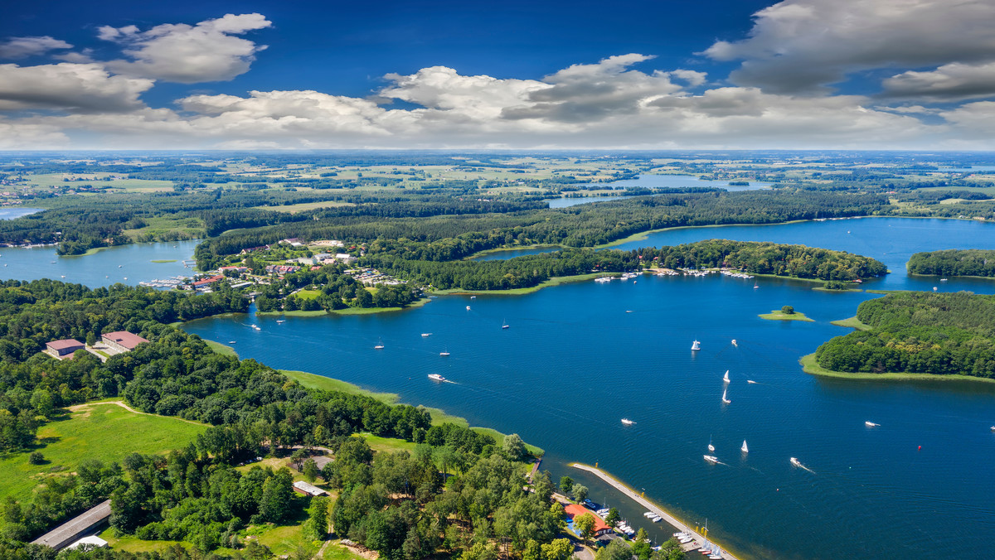
The Masurian Lake District,
the land of over 2000 lakes.

Slide 23
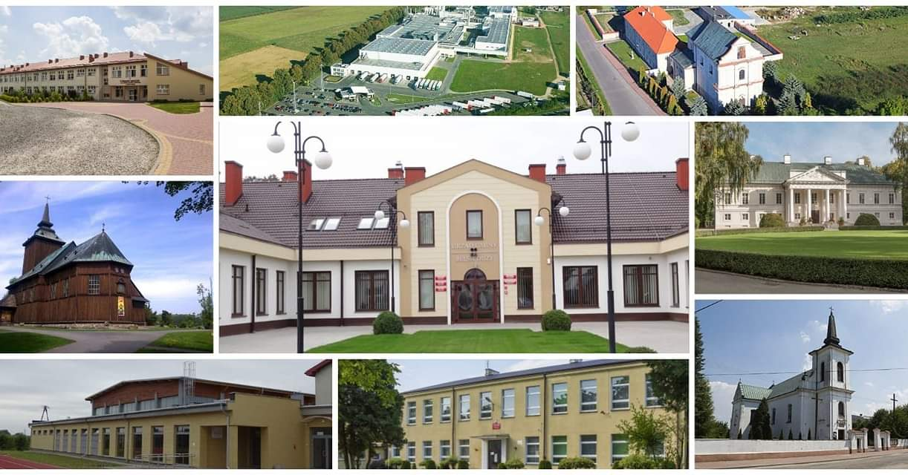
Belsk Duży district, that’s where we live.

Slide 25
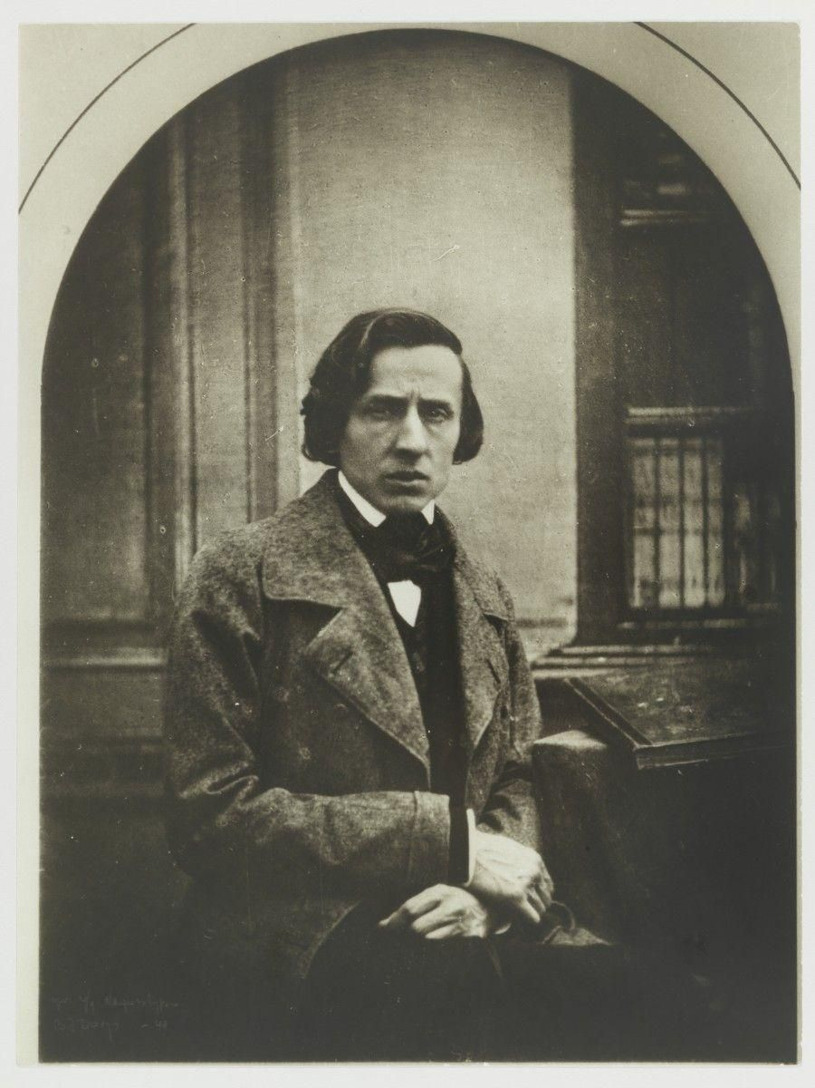
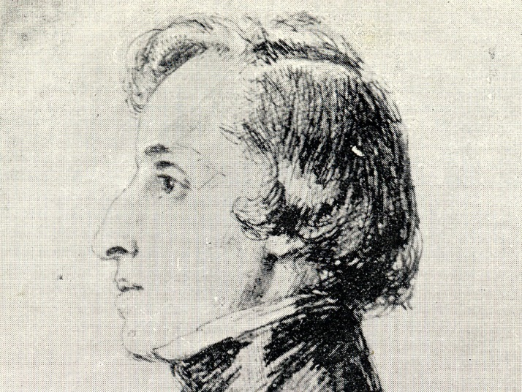
Frédéric François Chopin was a Polish composer
and virtuoso pianist
of the Romantic period.

Slide 26
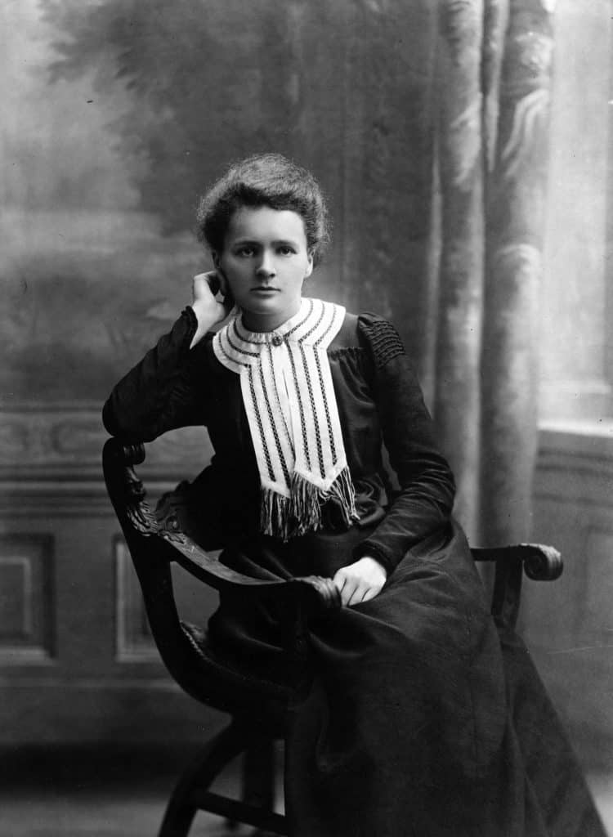
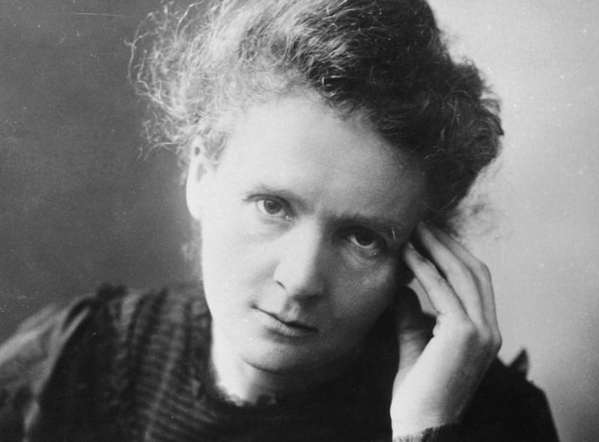
Marie Skłodowska–Curie
was a Polish physicist and chemist
who conducted
pioneering research on radioactivity.
She was the first woman
to win a Nobel Prize,
the first person
to win a Nobel Prize twice,
and the only person
to win a Nobel Prize
in two scientific fields.

Slide 27
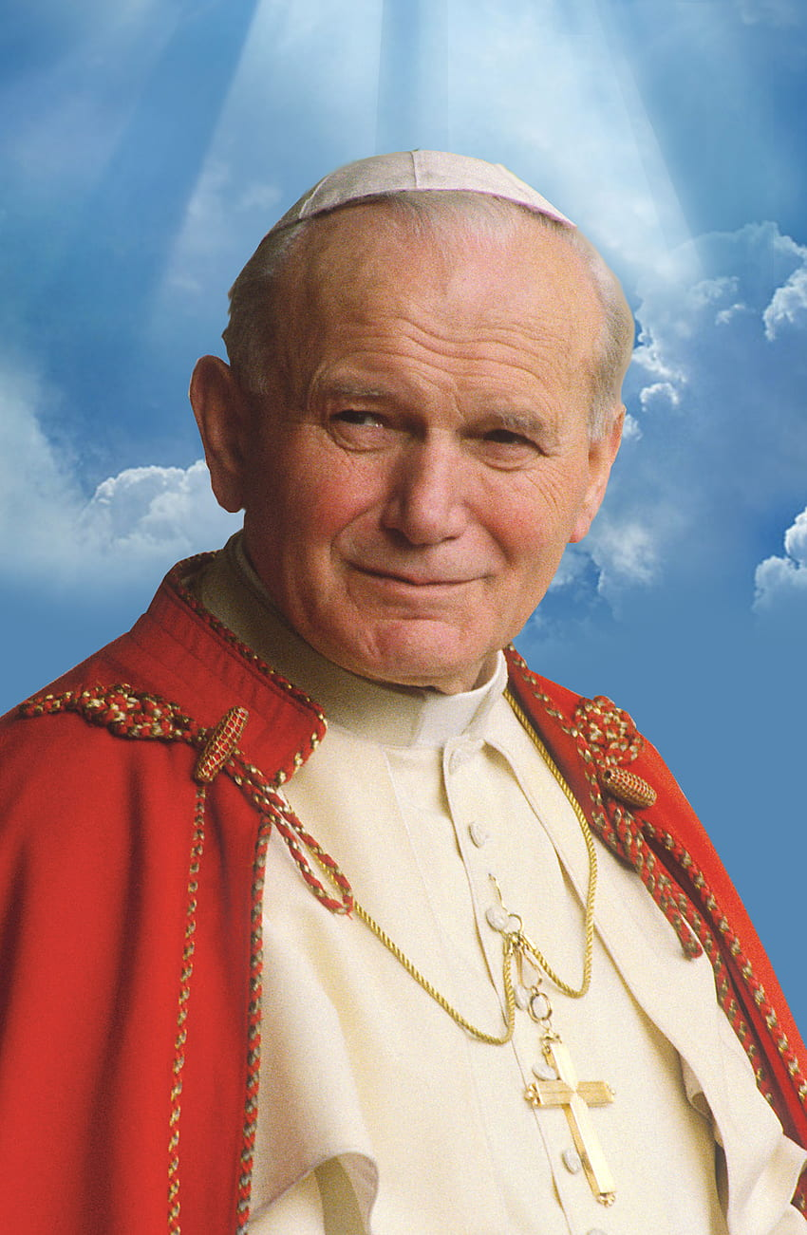
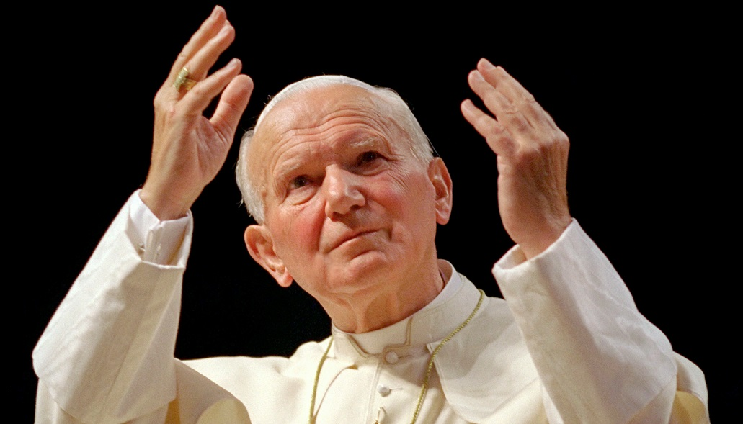
Born in Poland,
Saint John Paul II
(previously Karol Wojtyła)
was the first non-Italian pope
since Adrian VI in the 16th century
and the third longest-serving pope after Pius IX and St. Peter.
Pope John Paul II
was head of the Catholic Church
from 1978 until his death in 2005.
He is the patron of our school.

Slide 28
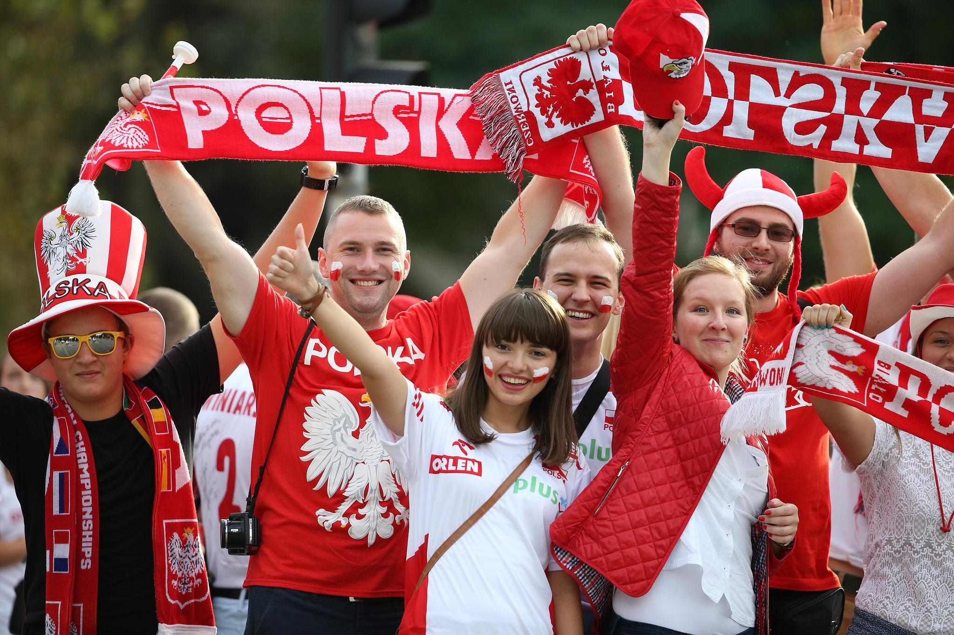
See you in Poland!

